Slide 1


Inbrain Workshop
FMRIB Software Library (FSL)
Luiza Bezerra - luiza.licariao@usp.br

Slide 2
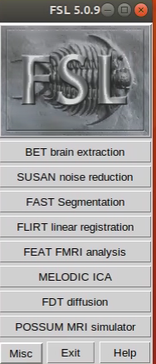
What can be done with FSL?
FSL is a software library containing analysis tools for functional, structural and diffusion MRI brain imaging.
Among the most generic functions of FSL are segmentation, registration and brain extraction.

Slide 3
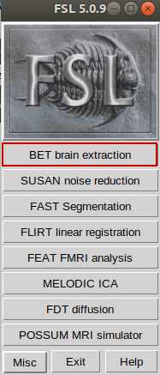
Brain Extraction - BET
Input: MR brain image
Output: Brain extracted image, binary brain mask and skull surface image.
Methods: bet2 and betsurf.
Notes:
bet2 - the main brain extraction program
betsurf - using a registered T1 and T2 image pair, estimates inner and outer skull surfaces and outer scalp surface

Slide 4
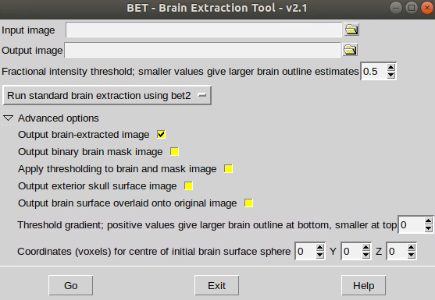
Brain Extraction - BET
Here you may change the threshold. Higher values creates greater erosion.
Those are some parameters you might want to change for better optimization.

Slide 5
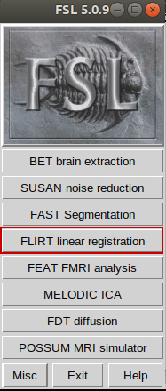
Registration - FLIRT
Input: For one-staged registration an image of reference and an image to be transformed must be given.
Output: Registered image and transformation file.

Slide 6
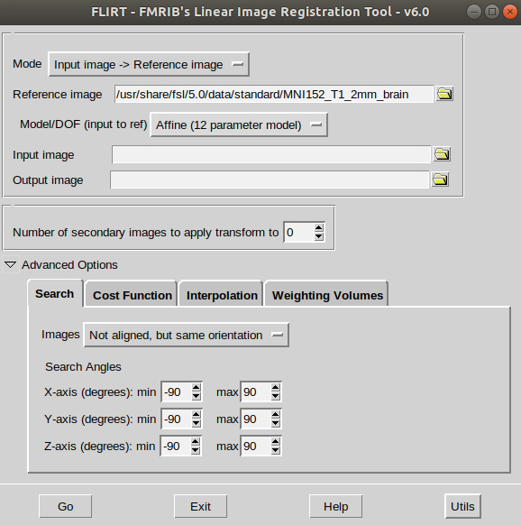
Registration - FLIRT
Select one or two staged registration.
Choose degrees of freedom
This transformation may be applied to other images.
Previous knowledge might be useful for better registration

Slide 7
How to evaluate the quality of image co-registration?
The co-registration is only completed after a cost function is satisfied, this in itself already guarantees a certain quality to the co-registration made.
The proposed metric for evaluating the co-registration was the Dice Coefficient. Below is a useful link to understand this coefficient:
https://www.kaggle.com/code/yerramvarun/understanding-dice-coefficient

Slide 8
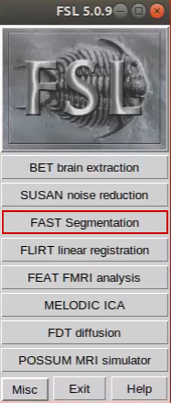
Segmentation - FAST
Input: T1, T2, proton density images.
Output: Probability maps, binary mask, bias field and input image with bias field correction.

Slide 9
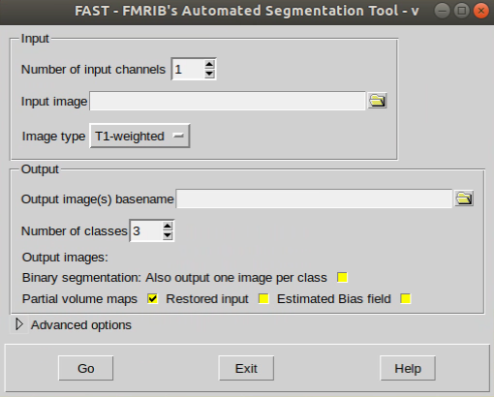
Segmentation - FAST
By default, FAST segments a 3D image of the brain into Grey Matter, White Matter and CSF.
Here you may select which outputs are of interest to you. FAST’s standard comes with only probability maps checked

Slide 10
For more information about FSL
FSL wikipedia page has an overview of the most used functions.
https://en.wikipedia.org/wiki/FMRIB_Software_Library
FSL functions documentation
https://fsl.fmrib.ox.ac.uk/fsl/fslwiki/FSL

Slide 11
Hands-on time!

Slide 12
www.inbrainlab.com
e-mail
OBRIGADA/THANK YOU!!

